Slide 1
Prayer Summit
Dec 2023
Notes:
Welcome 5 Mins (Shannon)
Welcome To Prayer Summit Explain Resource Table 5 mins
To all who came, but especially to those who have come for the first time! Welcome! Give them a brief overview of what they might expect at the meeting Allay their fears by explaining that they don’t have to do anything they don’t feel comfortable with
If they don’t want to pray out loud, they can pray silently
If they don’t know what to do, feel free to ask someone next to them
If they have disabilities, not to be embarrassed to sit when others stand or kneel
A table of resources available for them if they would like anything
(All such things not only allay their fears but send notice to everyone else of what their attitudes towards newcomers should be too.)
Worship: 10 min Smiths
~Song
~Song

Slide 2
Bless One Another
Notes:
Lance 8 mins
Partner up with your spouse
or a friend and lets speak life over one another!
Our words have the potential to do good or to do harm.
The Bible describes the potential impact of our words in verses such as these:
(Proverbs 18:21). “Death and life are in the power of the tongue: and they that love it shall eat the fruit thereof”
(Proverbs 16:24). “Pleasant words are as an honeycomb, sweet to the soul, and health to the bones”
A spoken blessing does good to those who hear it.
In the New Testament, the English word bless is a translation of the Greek word eulogeo.
which means “to speak well of, to bless or to thank or invoke a benediction upon, prosper):
When you bless others,
you speaking life over them and encouraging their walk in the Lord!
Perhaps you have never done a blessing before
This is a great safe place to start!!
it can be something as small and simple as
Pastor Pat…. I bless you. I speak God blessing over your life
Or it can be more specific like this
Pastor Pat… I bless you to be the father you were created to be
I bless you to be able to connect with your kids in a special close way
That the Lord would grant you wisdom like it says in James 1:5 to speak life deep into their hearts
Pat I bless you as a husband to Olinda
May the Lord bring you closer as a couple then you have ever been before
May he grant you times of refreshment to get away and build your marriage
I bless you as the student ministry pastor
In this world we have many orphans and broken
May you be a light that draws them in because they see the love you have in your heart
and as the draw close… May the Lord give you prophetic direction to speak as a spiritual father deep into their lives
and may the words you speak bring healing and restoration
May you see the broken flourish as you share the Hope of Jesus Christ!!!
Now you try it!!!

Slide 3
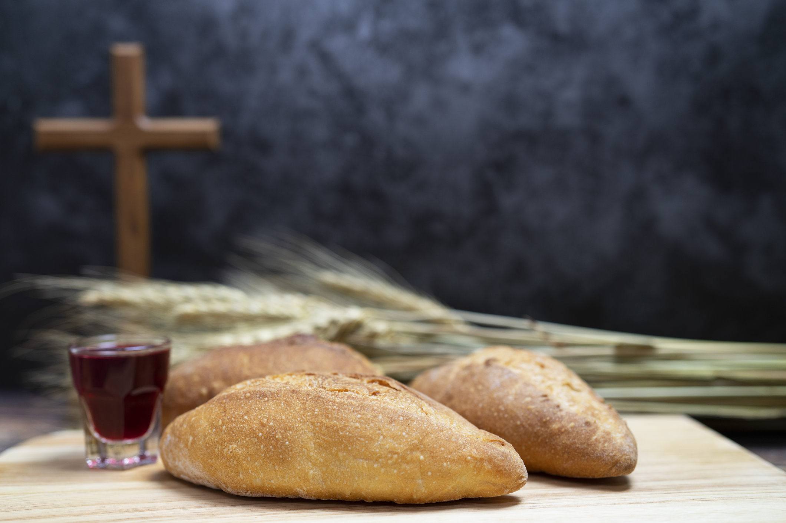
Notes:
communion Missy Live Music
5 mins Live Music while praying Lance
We are going to continue to worship the lord in Kneeling Prayer
Psalm 95:6 says, “Come, let us worship and bow down, Let us kneel before the LORD our Maker.”
Bowing and kneeling have long been associated with worship and reverence
(see 2 Chronicles 6:13; Psalm 138:2; Daniel 6:10).
In fact, the Hebrew word for “worship” actually means “bow down.”
Kneeling before God honors what Paul describes in Ephesians 3:12, “In him and through faith in him we may approach God with freedom and confidence...”
Then Paul continues in Vs 14 with saying: “For this reason I kneel before the Father”
So for 5 mins
If you are able…
let us kneel where you are at
and pour your heart out the the Lord in worship!!!
For He is good!!

Slide 4
Eagerly Desire The Gifts 1 Cor. 14:1
Notes:
1 Cor 14:1 Follow the way of love and eagerly desire gifts of the Spirit…
Elder prayer we started praying
(seeking actively not waiting passively)
If we read 1 Cor 14:1 in its entirety we read
First Corinthians 14:1 Follow the way of love and eagerly desire gifts of the Spirit, especially prophecy
For our practical exercise tonight, I would like us to spend time in prayer,
earnestly seeking the Lord and asking Him this question:
"Which gift of the spirit do you desire for me to eagerly pursue?”
remember that we are seeking actively not waiting passively

Slide 5
"Which gift of the spirit do you desire for me to eagerly pursue?"
Notes:
"Which gift of the spirit do you desire for me to eagerly pursue?"

Slide 6
Triads
Notes:
Now remember 1 Cor 14:1 tells us to eagerly desire the gifts…
especially prophecy!!
Now lets go into our triads
a safe place and practice that!
Tonight in triads we are going to
Listen for prophetic word for one another
choose one person to be ministered to…
then the other two spend a few mins in listening prayer…
I would encourage you to use your journals!
ASk the Lord what would you like me to share with whoever you are ministering too?
and then write it in your journal
when you are both finished share with one another what the Lord showed you!
remember in hearing God we talk about how to steward a word from the Lord
Start off with sentences like
I believe the Lord is showing me
or this is what I feel the Lord showed me you can do with it whatever you wish
These words will not be directional words
Like I think the lord is saying you should quite your job, or marry so and so
but they are words of encouragement and edification!!!
When you submit your word do so humbly because we know we all hear in part

